Slide 1
Freshman Core
Wednesday, January 6th

Slide 2
Agenda:
Opener: draw the brain
take roll,
put out folders
Parts of the brain handout & video
Make a brain!

Slide 3
Opener:
What do you know about the brain already?
Draw a picture of the brain and add any information you already know about it.

Slide 4
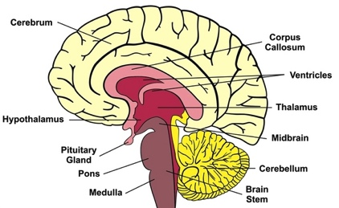
Notes:
Give them some examples of how they can label this.
Give them colors

Slide 5
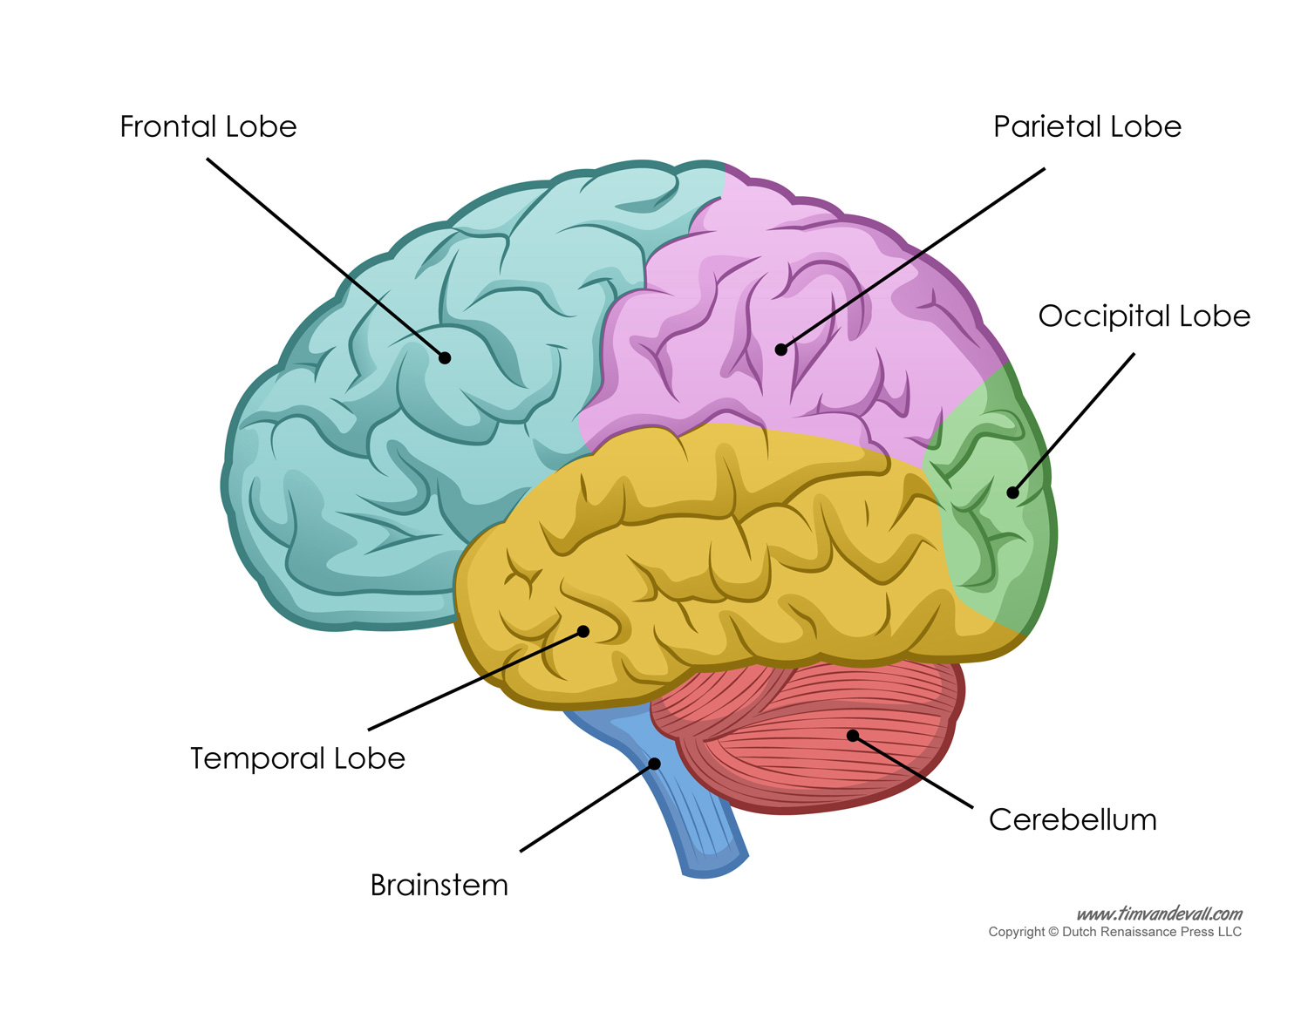
Cerebral Cortex
Notes:
Assign colors to each part so that there is no overlap or repeating
You need 10

Slide 6
The Brain
Watch the video and take notes on the parts in the handout. He will talk about more parts, but you don’t need to take notes on them if they are not listed.

Slide 7
Make a brain
Notes:
If time, give students different parts of the brain to make labels of. Have someone draw an enormous brain on a paper and other students come up and put their labels on the drawing in the correct places. Students can color, etc as they like.

