Slide 1
Freshman Core
Monday, January 4th

Slide 2
Opener
What is intelligence?
What does it mean to be smart?
What is IQ?
Can you change your intelligence level?
Notes:
Do this on paper
Talk about it talk about it talk about it talk about it

Slide 3
Agenda
Opener:
take roll,
put out folders
Growth vs. Fixed mindset lesson
Inspirational People Project

Slide 4
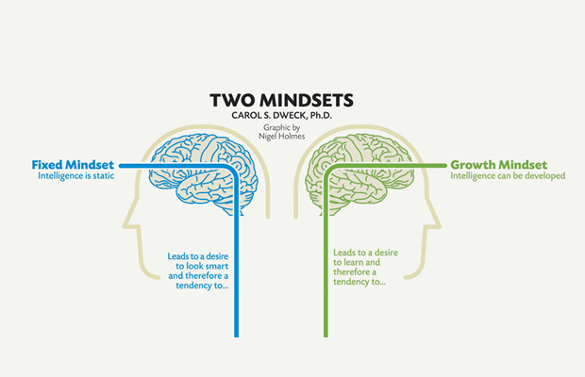

Slide 8
Think about your personal experiences. When have you overcome an obstacle? Reflect on times when you failed at first, but through perseverance were able to create new neural connections and become better at the task. Write yourself a letter reminding yourself of the power of perseverance and hard work. Use the idea of a growth mindset to encourage yourself to take on and overcome obstacles in the future. Your letter should be in letter format and 5-10 sentences. It can be typed or handwritten.

