Slide 1
Freshman Core
Monday, January 11th

Slide 2
Agenda:
Opener:
Draw a brain
take roll,
put out folders
Discuss article questions
Brain charades
Quiz!
Media and Insomnia article

Slide 3
Draw a picture of the brain and label what you can

Slide 4
Brain Charades
Divide class up into small groups of 2 or 3.
Have them pull a paper from the basket.
Have each group come up with a way to demonstrate what their part does. Then have the rest of the class guess.

Slide 5
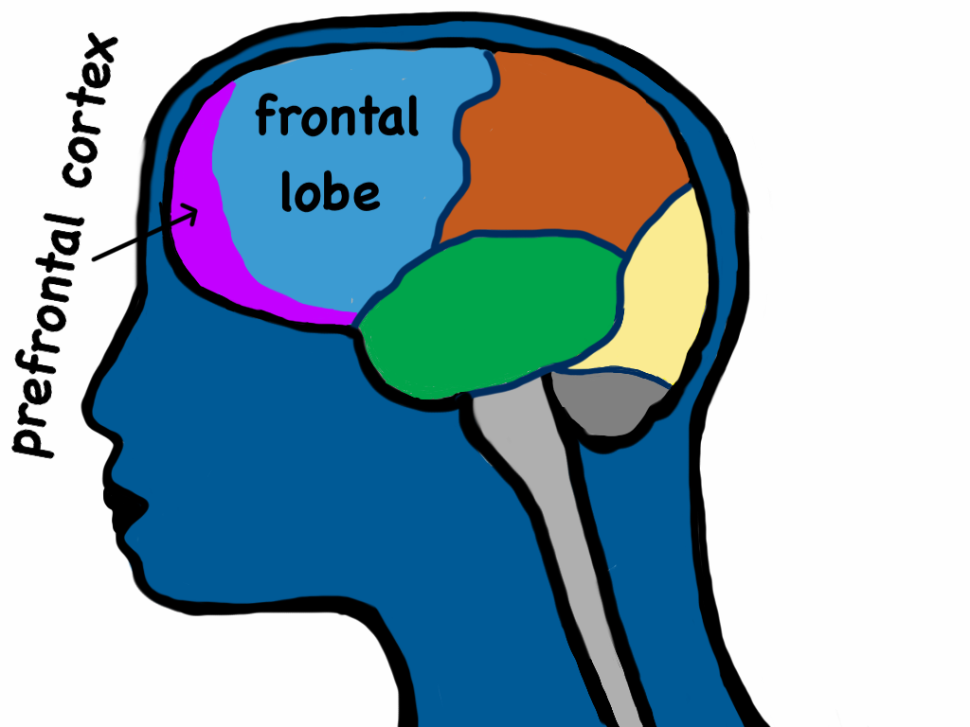

Slide 6
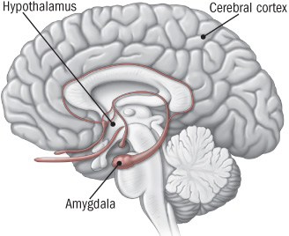

Slide 7
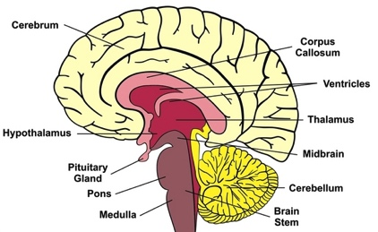
Notes:
Give them some examples of how they can label this.
Give them colors

Slide 8
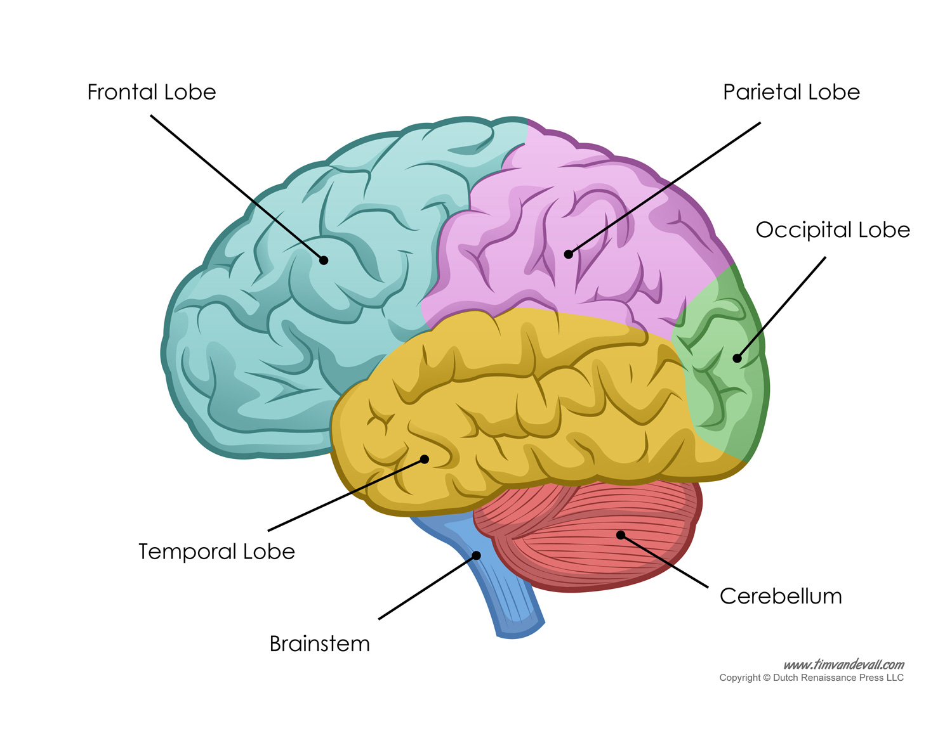
Cerebral Cortex
Notes:
Assign colors to each part so that there is no overlap or repeating
You need 10

